Slide 1
Capstone Project – The Battle of Neighborhoods
Finding a location for a Vietnamese restaurant in toronto

Slide 2
Introduction: Business Problem
In this project we will try to find an optimal location for a Vietnamese Restaurant in Montreal, Canada.
We will try to detect locations that aren't already crowded with restaurants and we are especially interested in areas that aren't crowded with Vietnamese Restaurants. We would prefer if the location is close to the center of the city, assuming the first two conditions are met.
We will be using data science tools to find a few promising neighborhoods where we can open the Vietnamese Restaurant based on the criteria above.

Slide 3
Data
The factors below are what is going to influence our decision:
Number of any type of restaurant in neighborhood
Number of Vietnamese restaurants in neighborhood
Distance of neighborhood from city center
We decided to just use a database found on https://worldpostalcode.com/canada/quebec/montreal for our neighborhoods that are linked to the postal codes. We will also need to use the following data sources:
Google Maps Api Geocoding to get latitude and longitude
Restaurant data from Foursquare API

Slide 4
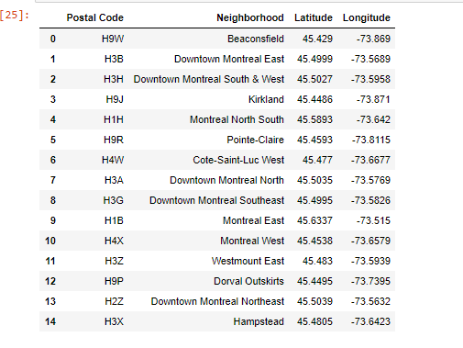
Neighborhoods Dataframe

Slide 5
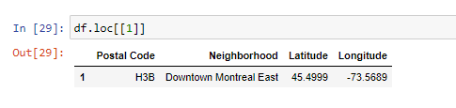
Center of the City
After researching we find out the center of Montreal is Downtown Montreal East and we’re going to work with that

Slide 6
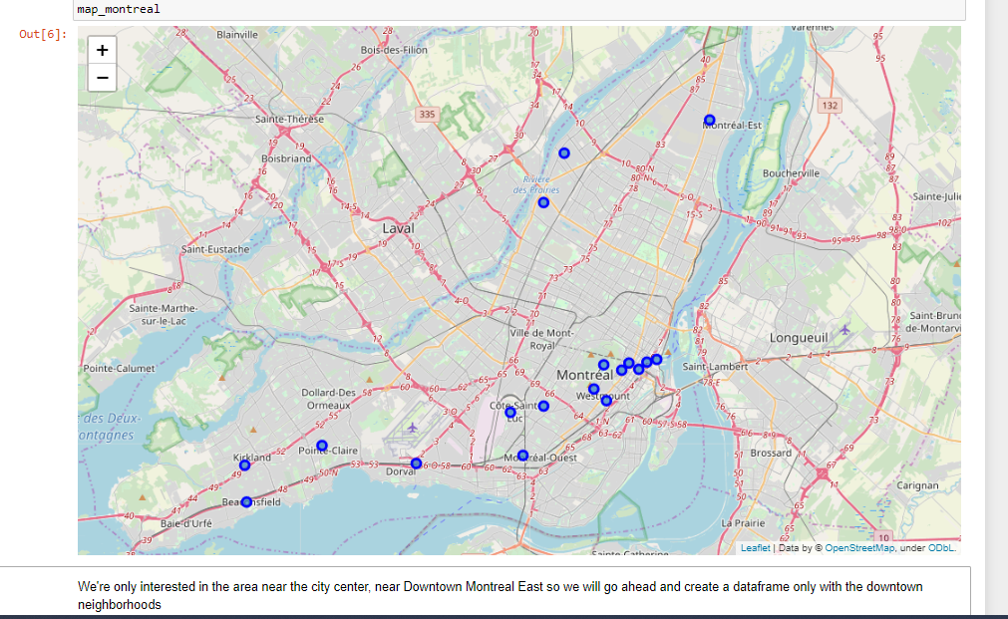
Visualizing the Neighborhoods

Slide 7
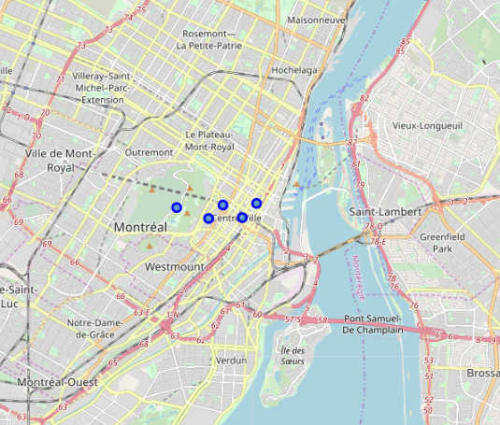
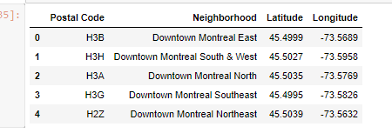
Downtown Neighborhoods
We’re only interested in the area near the city center, near Downtown Montreal East so we will go ahead and create a dataframe and map with only downtown neighborhoods

Slide 8
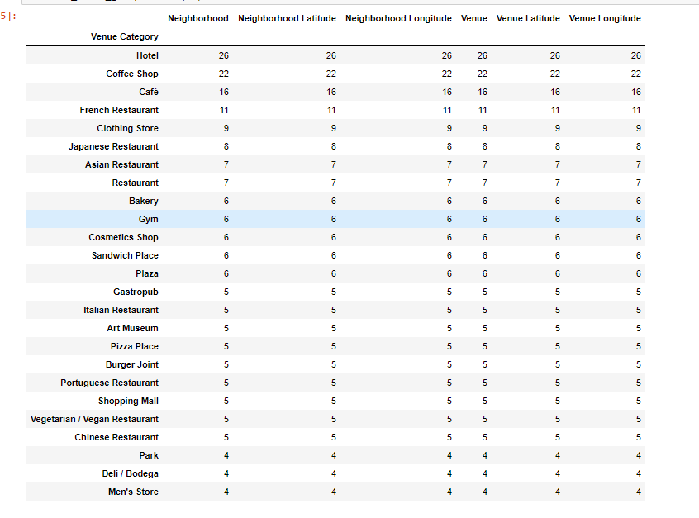
Foursquare API
We use Foursquare API and we get the Venues information where we can see how many of each of the categories of venues we have in these neighborhoods
We do not see any Vietnamese
Restaurants

Slide 9

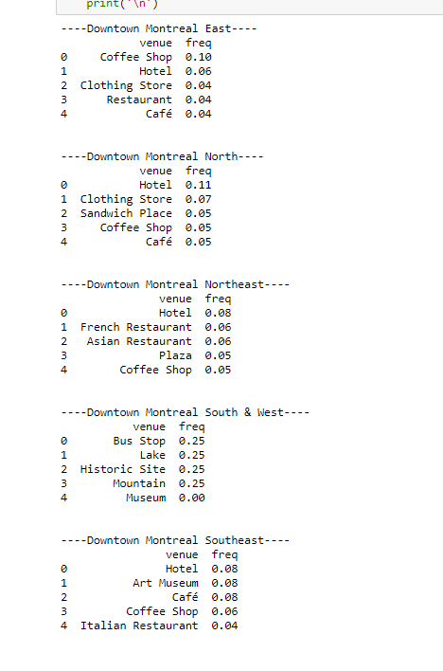
Analyzing each neighborhood
We see in the data that restaurants are top venues in 4 out of the 5 neighborhoods

Slide 10
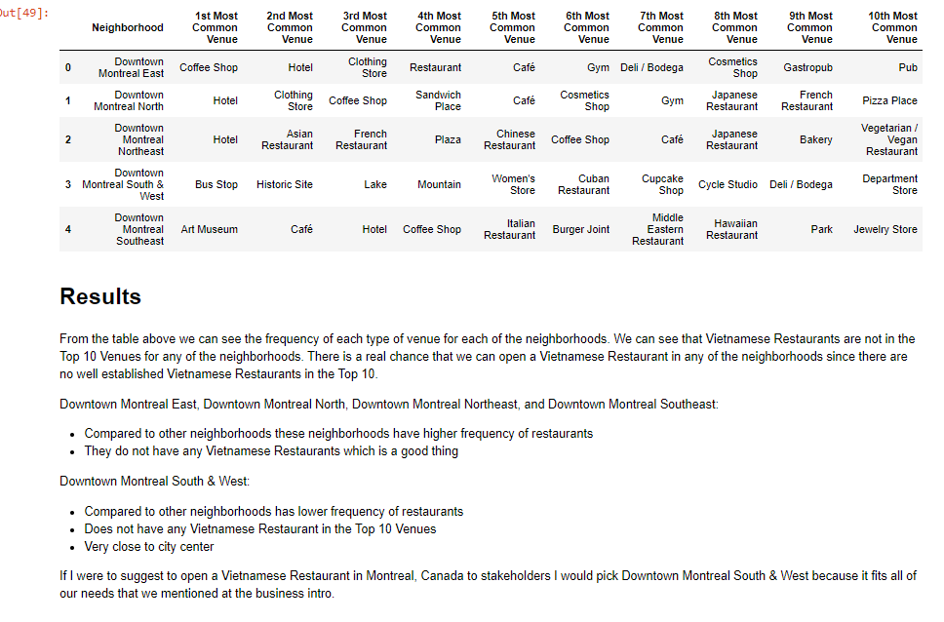
Results & Conclusion

